Slide 1
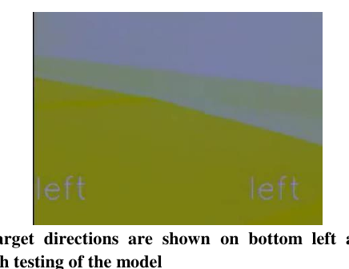
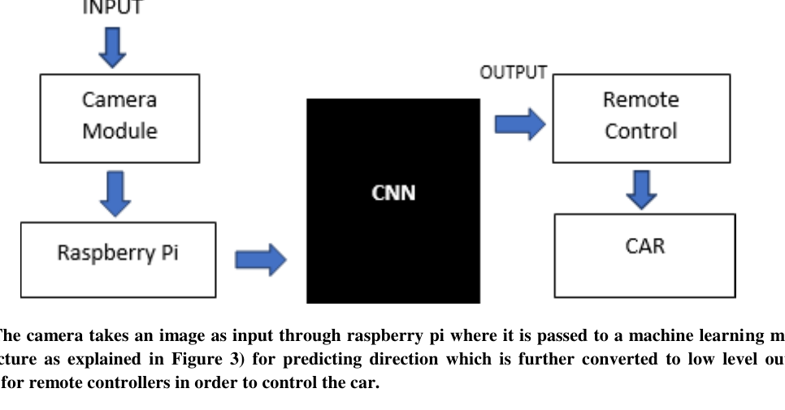
RESEARCH PRESENTATION
Smart Autonomous
Vehicle Using
End-to-End Learning
A low-cost RC-car platform that maps camera pixels directly to driving commands through a CNN.
Pranav Gupta • Vaibhav Singh • Anubha Parashar
Journal of Innovation in Computer Science and Engineering, Vol. 9(2), Jan–June 2020
Smart Autonomous Vehicle Using End-to-End Learning
01

Slide 2
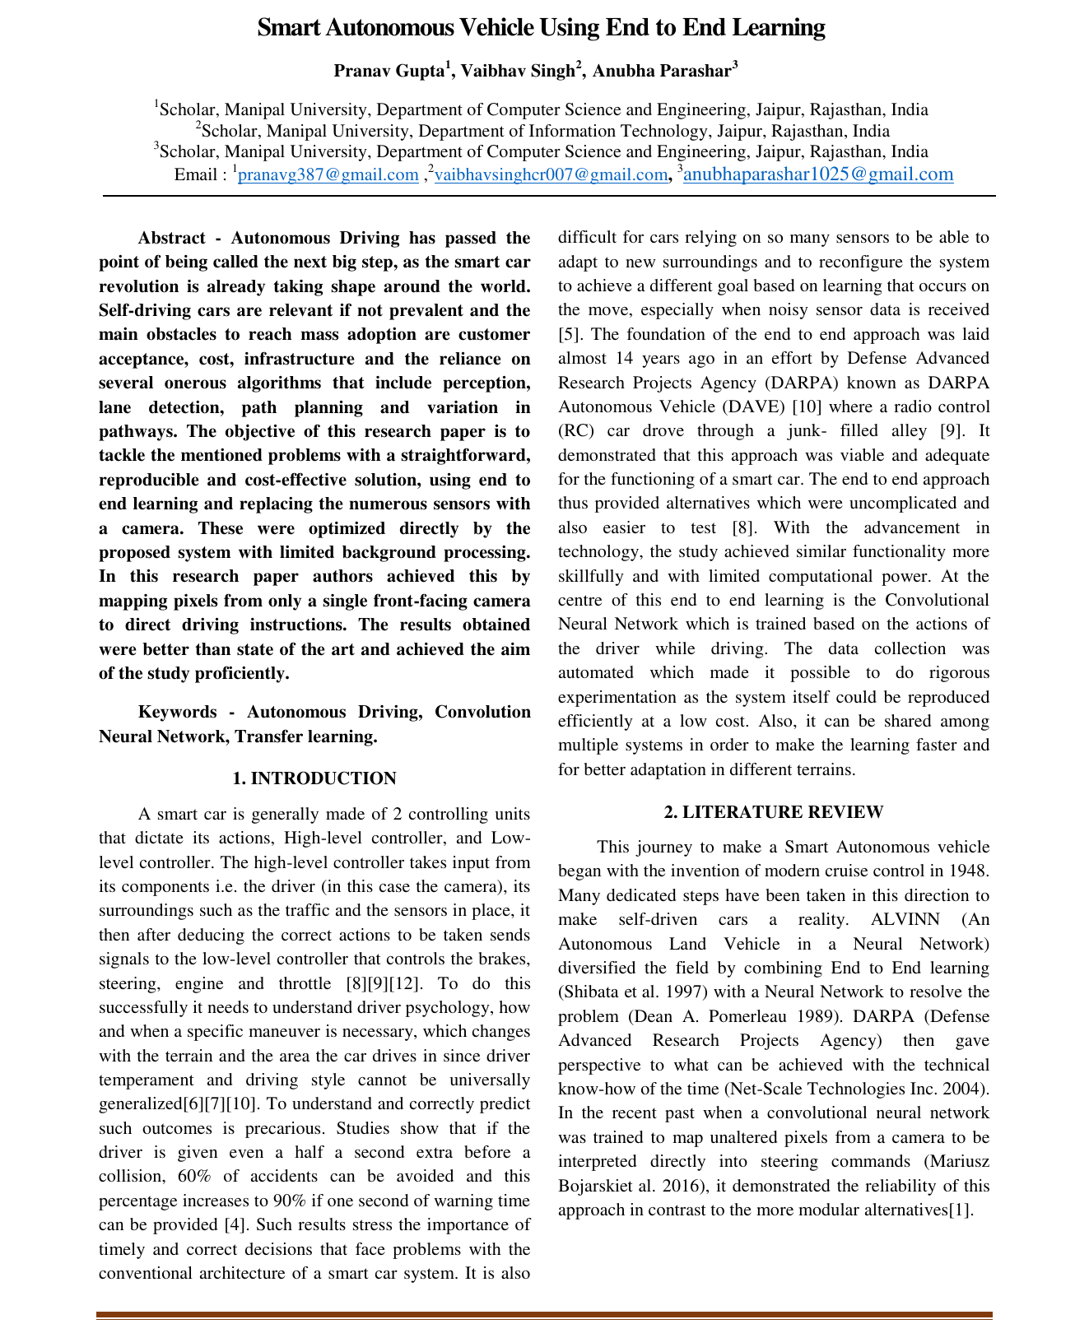
SMART AUTONOMOUS VEHICLE
Why end-to-end learning?
Traditional self-driving systems rely on several separate modules and many sensors. The paper proposes a simpler path: use a single front-facing camera and learn the steering decision directly.
1
3
98%
front-facing camera
driving commands
reported accuracy
Core motivation
Reduce sensor complexity and cost
Avoid hand-engineered perception and lane modules
Enable a reproducible autonomous RC-car setup
Smart Autonomous Vehicle Using End-to-End Learning
Source: paper abstract and methodology
02

Slide 3
SMART AUTONOMOUS VEHICLE
System idea: pixels to driving commands
The full pipeline converts camera frames into low-level commands for the RC vehicle.
CNN
Model
Camera
Module
Raspberry
Pi
Remote
Control
RC Car
Input
Decision
Output
Image frames from Pi camera mounted on top of the RC car.
VGG16-based CNN predicts left, right, or forward.
Raspberry Pi triggers GPIO-based remote commands.
Smart Autonomous Vehicle Using End-to-End Learning
Source: Figure 1, methodology
03

Slide 4
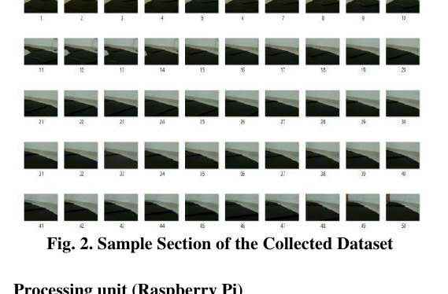
SMART AUTONOMOUS VEHICLE
Data collection and training set
Figure 1: capture → inference → movement
Figure 2: sample collected frames
Udacity simulator validated the plan before hardware testing.
Custom dataset was collected from self-laid tracks using the Pi camera.
Frames were time-synchronized with the control command: left, right, or forward.
Smart Autonomous Vehicle Using End-to-End Learning
Source: Section 3.1, Figures 1–2
04

Slide 5
SMART AUTONOMOUS VEHICLE
Pre-processing made the model robust
The paper emphasizes lightweight feature preparation before training the neural network.
Crop + resize
YUV color space
Flip turns
Remove unnecessary image area and reduce memory.
Efficient representation for vision tasks.
Augment left/right turning data.
Brightness jitter
Gaussian blur
Normalize classes
Handle varied lighting conditions.
Smooth noise in camera frames.
Reduce straight-driving bias.
Goal: convert small camera frames into reliable driving decisions with limited computation.
Smart Autonomous Vehicle Using End-to-End Learning
Source: Section 3.3, feature extraction
05

Slide 6
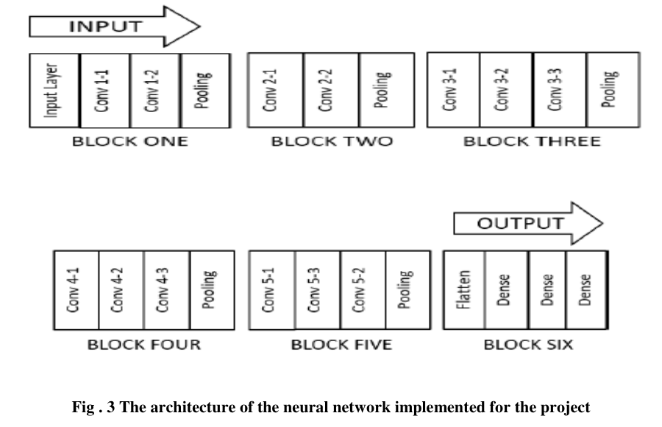
SMART AUTONOMOUS VEHICLE
CNN architecture: transfer learning with VGG16
Architecture summary
Input: 3 × 224 × 224 image
Pre-trained VGG16 used for feature extraction
Top fully-connected layers replaced
Two dense layers of 128 units each
Output: 3 classes — left, right, forward
Training setup
Adam optimizer, learning rate 0.01, categorical cross-entropy loss.
Smart Autonomous Vehicle Using End-to-End Learning
Source: Section 3.4, Figure 3
06

Slide 7
SMART AUTONOMOUS VEHICLE
Hardware deployment on an RC car
The prototype connects perception, processing, and actuation through Raspberry Pi and GPIO-driven remote control.
Pi Camera
Raspberry Pi
Serial Interface
GPIO Signals
RC Remote
What the Pi does
How actuation works
Why it matters
Receives frames, runs neural-network inference, and sends the predicted command.
The Pi simulates remote button presses by writing HIGH/LOW signals to GPIO pins.
The setup is low-cost, reproducible, and suitable for controlled-environment prototyping.
Smart Autonomous Vehicle Using End-to-End Learning
Source: Sections 3.2–3.3
07

Slide 8
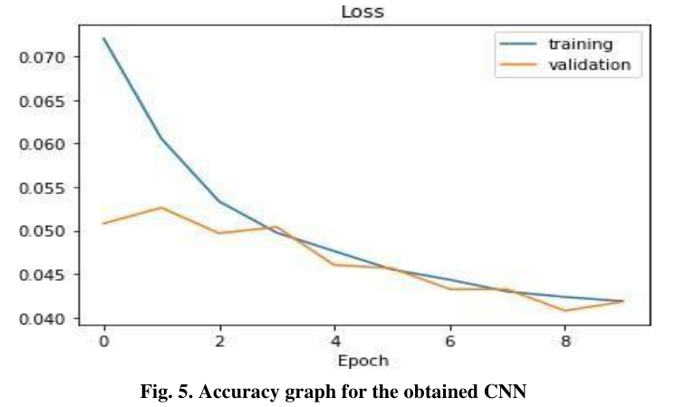
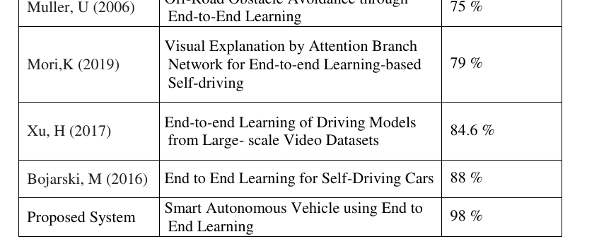
SMART AUTONOMOUS VEHICLE
Result: strong reported accuracy
The proposed model reported the highest accuracy in the comparison table.
Muller 2006
75%
Mori 2019
79%
Xu 2017
84.6%
Bojarski 2016
88%
Proposed
98%
98% proposed system accuracy
Loss trends down across epochs and the comparison table places the proposed system above prior end-to-end driving studies cited in the paper.
Smart Autonomous Vehicle Using End-to-End Learning
Source: Section 4.2, Figures 4–5, Table 1
08

Slide 9
SMART AUTONOMOUS VEHICLE
Conference recognition
The work was presented at ICICSE-2020, hosted virtually by Guru Nanak Institutions Technical Campus and Guru Nanak Institute of Technology.
Paper title
Smart Autonomous Vehicle Using End To End Learning
Conference
8th International Conference on Innovations in Computer Science & Engineering
Dates
August 28–29, 2020 • Virtual conference
Smart Autonomous Vehicle Using End-to-End Learning
Source: uploaded e-certificate
09

Slide 10
Conclusion & future scope
Main takeaway
Practical value
Future work
End-to-end learning is a viable alternative to hand-engineered autonomous-vehicle pipelines in controlled environments.
The setup is low-cost, camera-based, reproducible, and deployable on an RC-car prototype.
Improve hardware actuation with precise angle control and test on more complex road conditions.
Thank you
Questions?
Smart Autonomous Vehicle Using End-to-End Learning
Source: paper conclusion
10

